Slide 1

UAV Path Planning for Wireless Data Harvesting: A Deep Reinforcement Learning Approach
Harald Bayerlein¹ , Mirco Theile² , Marco Caccamo² , and David Gesbert ¹
Communication Systems Department, EURECOM, Sophia Antipolis, France
TUM Department of Mechanical Engineering, Technical University of Munich, Germany
IEEE Global Communications Conference (GLOBECOM) 2020
Code available: hbayerlein/uav_data_harvesting: Python implementation of DDQN multi-UAV data harvesting (github.com)
Notes:
UAV -> unmanned aerial vehicle (無人機)

Slide 2
Outline
Abstract
Introduction
System Model and Problem Formulation
Methodology
Stimulation
Conclusion

Slide 3
Abstract
Use double deep Q-network(DDQN) with experience replay for UAV to collect data from IoT devices in urban environment
Problem:
drone when collect data from sensor nodes
Limited flying time
Obstacle avoidance
Expensive re-computation or relearn when important scenario parameter change
Number of sensor, sensor position, maximum flying time
Goal:
Enable agent to make movement decision for variety scenario parameter that balance the data collection with flight time efficiency and safety constraint
Notes:
double deep Q-network -> RL的一種變形
在這篇論文前,當parameter改變的時候, 那些用於UAV的路徑規劃的方法都需要重新計算
目標:
希望agent在不同的scenario parameter下都可以選擇一個好的決定

Slide 4
Introduction
UAV application in telecommunication:
Cellular-connected UAVs attached to mobile network links
UAVs provide communication service themselves
Challenges in collecting data in urban area:
Battery life
Obstacle avoidance
Regulatory no-fly zone (NFZs)
Wireless communication channel characteristics can be affected by attenuation of line-of-sight(LoS) and non-line-of-sight(NLoS) [between UAV and IoT device]
Notes:
Cellular-connected UAVs attached to mobile network links
無人機基站 -> 幫助原本的基站提供網路
UAVs provide communication service themselves
從iot sensor收集資料然後上傳
小知識:
日立已經有一個半自動化的UAV在一些大型設施建築物幫忙收集IoT sensor的資料
line-of-sight(LoS)
視距條件下，無線信號無遮擋地在發信端與接收端之間”直線“傳播
non-line-of-sight(NLoS)
非視距通信 有障礙物的情況下，無線信號只能通過反射，散射和衍射方式到達接收端, 無線信號通過多種途徑被接收

Slide 5
Introduction
Main contribution of this paper:
Introduce new DDQN-based method to maximized collected data under flying time and navigation constraint without prior information about the wireless channel characteristics
Show an increase in learning efficiency when exploiting a centered multi-layer map of environment
Learning to effectively adapt to variation in environment and scenario parameter

Slide 6
System Model and Problem Formulation (System Model)
Environment:
Square grid world of size M x M
UAV collect data from K static IoT device
These device located on ground level at u_{k} = [x_{k}, y_{k}, 0]^{T}
Collection mission end at time T and time horizon is discretized into equal mission time slots t
UAV’s position = [x(t), y(t), h]^{T} where h = constant altitude
UAV’s 2d projection on ground, p(t) = [x(t), y(t)]^{T}
Partition each t into δ communication time slot
Communication time index = n

Slide 7




System Model and Problem Formulation (System Model)
Communication link between UAV and IoT devices
LoS/NLoS point-to-point channel with log-distance path loss and shadow fading
, information rate at time n for k-th device
SNR_{k}(n) = signal-to-noise ratio =
Sensor node served by UAV in TDMA method
In each communication time slot n, sensor node k with highest SNR with remaining data to be uploaded will be pick up by scheduling algorithm
TDMA constraint for scheduling variable q_{k}(n) =
Achievable throughput for 1 mission time slot t = sum of achieved rates of corresponding communication time slot n over K sensor nodes
Notes:
Log-distance path loss ->預測環境的傳播損耗
Shadow fading -> 傳播路徑上會有遮蔽物, 訊號就會有不同程度的衰減, 當使用者在移動的時候, 環境也會不一樣, 所以shadow fading也會不一樣
SNR -> 對比signal和noise -> ratio 越高, 訊號品質越好
transmit power Pk, white Gaussian noise power at the receiver σ 2 , UAV-device distance dk(n), path loss exponent αl and ηl ∼ N (0, σ2 l ) modeled as a Gaussian random variable
TDMA(Time Division Multiple Access) -> 把訊號切成不同的time slot讓多個使用者分享這個channel, 每個使用者給一個time slot讓他在那個time slot裡去使用這整個channel的資源

Slide 8
System Model and Problem Formulation (System Model)
p(t+1)
Constraint:
UAV limited to move with constant velocity or hovering
UAV’s position need to interpolated linearly between p(t) and p(t+1) so that channel gain is constant within 1 communication time slot
Goal of this trajectory optimization problem:
Maximize throughput over whole data collection mission
Minimize flight duration, subject to the constraint of maximum flight time, adherence to NFZs, obstacle avoidance and safe landing in designated landing area
Translate this optimization problem into reward function in Markov decision process
p(t)
Notes:
Constraint:
Mission time slots are chosen sufficiently small so that the UAV’s velocity v(t) can be considered to remain constant in one time slot. Velocity = displacement / change in time
the number of communication time slots per mission time slot δ is chosen sufficiently large

Slide 9
System Model and Problem Formulation (Markov Decision Process, MDP)
MDP is defined by tuple (S,A,R,P)
S = state space
A = action space
R = reward space
P = probabilistic state transition function, P : S x A x S
State at mission time t in grid world of size M x M , s_{t} = (D_{t}, p_{t}, b_{t}, M, U)
D_{t} = initially available and already collected data for each device
p_{t} = UAV position projected on ground
b_{t} = UAV’s remaining flying time
M = map of physical environment in Boolean domain, encoded with 3 map layers (start/landing position, NFZs, buildings)
U = 2D coordinate of K IoT device

Slide 10

System Model and Problem Formulation (Markov Decision Process, MDP)
Total size of state space:
Action space for UAV, A = {north, east, south, west, hover, land}
Reward function maps state-action pairs to a real-valued reward and has 4 components
r_{data} (positive) : data collection reward given by achieved throughput in current time slot
r_{sc} (negative) : safety controller (sc) penalty if drone enter NFZs or need to prevent drone from colliding with building
r_{mov} (negative) : constant movement penalty is applied for every action the UAV takes without completing the mission
r_{crash} (negative) : penalty if drone reach its flying time and did not landed safety in landing zone

Slide 11
Methodology (Q-learning)
Environment
State
Reward
Action
Agent

Slide 12


Methodology (Q-learning)
Q-function:
R_{t} = discounted cumulative return
Discount factor, γ, balancing the importance of immediate and future reward

Slide 13
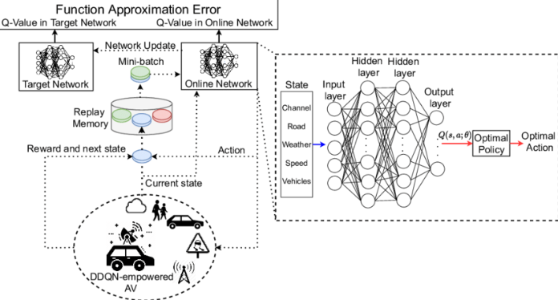
Methodology (Double Deep Q-learning and Combined Experience Replay)
s,a,r,s’
Double Deep Q-Network (DDQN) approach for the AV. | Download Scientific Diagram (researchgate.net)

Slide 14


Methodology (Double Deep Q-learning and Combined Experience Replay)
Train network with parameters θ to minimize loss function
Loss function:
s = s(t), a = a(t), s’ = s(t+1), a’ = a(t+1)
Target value, Y(s, a, s’)

Slide 15

Methodology (Centered Global Map)
Global map = static environmental map + dynamic device data map
Global map formatted as 2 real-valued map layers
1st layer = data available for collection from each device at its respective position
2nd layer = data that has already collected throughout the mission
Input space
This paper states that centered map layer can benefits its ability to generalize over varying scenario parameter

Slide 16
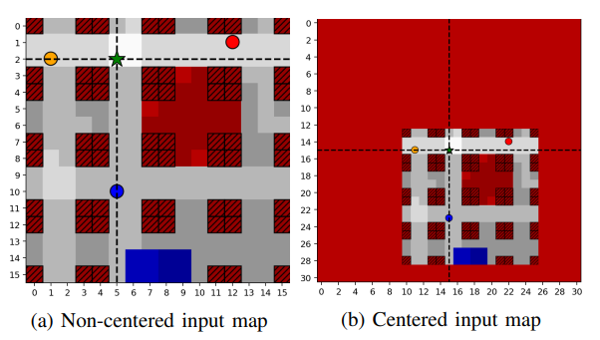
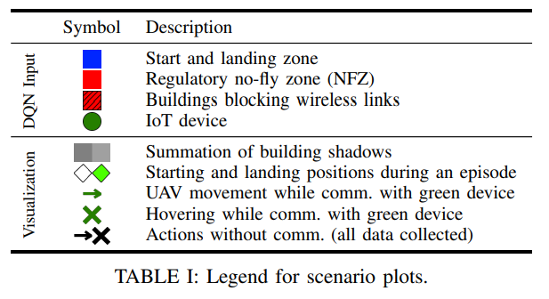
Methodology (Centered Global Map)
Notes:
Map會expand成2M-1

Slide 17
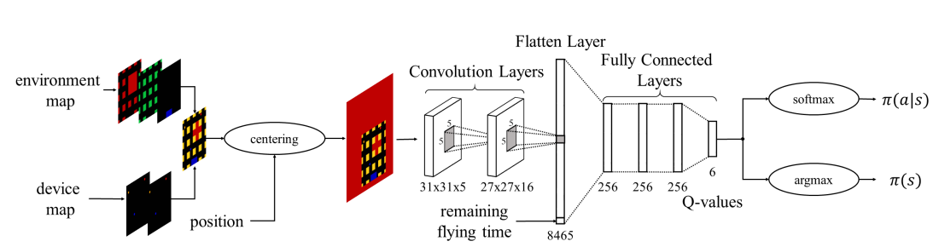

Methodology (Centered Global Map)

Slide 18
Methodology (Centered Global Map)
Input Map | Neurons in Flatten Layer
Non-centered | Correspond to features at absolute position
Centered | Correspond to features at relative position
Since agent’s action based on its relative position to feature
Its learning efficiency increase

Slide 19


Methodology (Neural Network Model)
(concatenate)
Argmax of Q-value
Soft-max policy
Temperature parameter, β, scales the balance of exploration and exploitation
Notes:
Centered map餵進使用了ReLU activation 的 convolution layers, 然後經過flatten.
跟剩餘的flying time concatenate 起來
經過使用了ReLU activation的fully connected layer
最後一個fully connected layer並沒有activation function而且size = action space
Output 每個action的Q value
Softmax policy含有一個softmax function, softmax function把output轉換成機率分布

Slide 20
Stimulations (Stimulation Setup)
UAV works in 16 x 16 cells where each cell has size 10m x 10m
UAV has remaining flying time of T steps, and T decreasing by 1 after every action agent takes
UAV flies at constant altitude, h=10m
Each mission time slot has δ = 4 communication time slots
α_{LoS} = 2.27, α_{NLoS} = 3.64, σ²_{LoS} = 2, σ²_{NLoS} = 5
Shadowing map were computed using ray tracing from and to the center points of cell
Transmission and noise powers are normalized through cell-edge SNR = -15dB
Agent has no prior knowledge about shadowing map or wireless channel characteristics
Notes:
Shadowing map用來模擬環境
解釋了在map的最中間的無人機與在網格角落沒有被阻擋的device的SNR

Slide 21
Stimulations (Stimulation Setup)
Evaluate agent’s performance per episode:
Cumulative reward
Has landed
Collection ratio
Collection ratio and landed
Has landed x collection ratio
During training, agent’s training progress is evaluated in randomly selected scenario every ten episode and average all those evaluation
Impossible to try all possible scenario variation, so use Monte Carlo analysis to randomly select scenario parameter combination
Notes:
Collection ratio = ratio of collected data and total initially available device data
Monte Carlo analysis是一個統計模擬方法, 使選到的參數與原始数据的differences尽可能的小

Slide 22
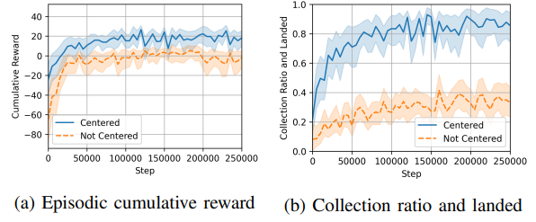
Stimulations (Centered vs Non-Centered Map)
Input of non-centered agent has same shape as centered agent
Difference between these 2 agents:
Non-centered agent receive position as 2D-hot encoded map layer
2D hot encoded map layer: encoding of occupied cell inside whole grid
Each graph is averaged over 3 training runs to account for possible random variations in training process
Notes:
整個網格內佔用單元格的編碼
With the position encoded in this way, it can be stacked with the three-channel map and the coverage grid to form the five-channel input of the network’s convolutional layers (?)

Slide 23
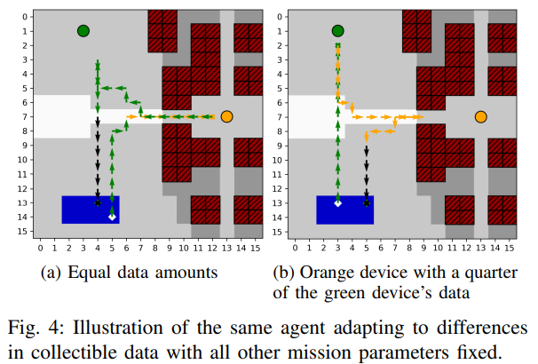
Stimulations (Collectible Data and Device Accessibility)
Fixed number of IoT device, K=2
Randomized
Device position in unoccupied map space
Collectible data for each device (D₀ ∈ [1.0, 25.0] data units)
Flying time limits (b0 ∈ [35, 70] steps)
8 possible start position
Notes:
當資料量一樣, 先收集橙色的data再收集綠色的
當綠色的資料量比橙色的多, 先收集綠色的

Slide 24
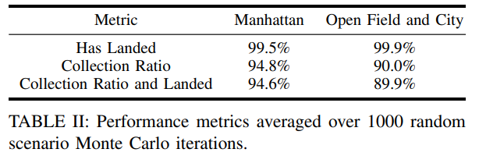
Stimulations (Manhattan-like city Scenario)
Stimulate its distributed city blocks with street and NFZ district
To demonstrate agent’s ability to generalize over significant variations in scenario parameters with randomly changing device count, device data, maximum flying time and 8 possible starting position
Evaluated using Monte Carlo stimulations

Slide 25
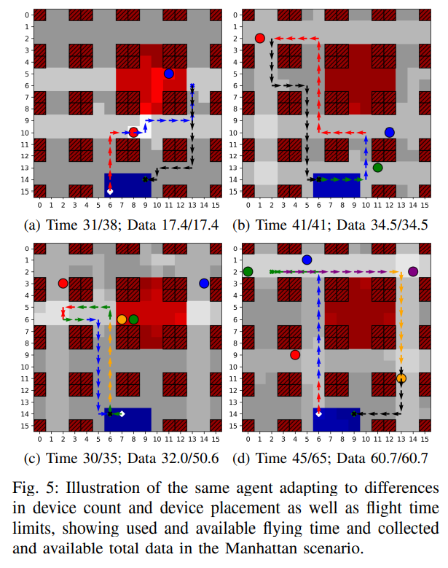
Stimulations (Manhattan Scenario)
Notes:
5.A : 因為shadowing effect還有NFZ, 無人機再規劃到藍色IoT的路線時就比較複雜
5.B : 紅色比較遠
5.C : 藍色很遠, flying time 35沒有辦法收集全部就先回來
5.D : 規劃了一個在最短時間內收集全部資料的路線

Slide 26
Conclusion
With the neural network that exploit information about environment from centered map layers through convolutional processing, agent can learn to effectively adapt to significant variation in the scenario without retrain or recollect training data
UAV can also balancing goal of data collection, obstacle avoidance and minimize mission time without any prior information about wireless channel characteristic
Future work:
Tackle issue of scalability to larger map
Combine with multi-task reinforcement learning or transfer learning
Extend UAV’s action space to altitude control

Slide 27
Opinion
Consider many factors that will appear in real world
Signal attenuation
NFZs
Apply DDQN to UAV path finding

Slide 28
Thank you

